Slide 1

A theory of morphological productivity is essential in characterizing noun classes: Corpus and experimental evidence from Bantu
Patrick Kanampiu, Alexander Martin, Jennifer Culbertson
TTFA Talk Series, Leiden University
(April 14, 2023)

Slide 2
Noun class systems
Nouns grouped based on agreement (Hockett 1958, Corbett 1991, Katamba 2006)
Used interchangeably with gender (Corbett, 1991:1; Aikhenvald, 2006)
Kîîtharaka
(1) | mûthaka | ûra
 | 1.young man | 1.dem.dist
(2) | kîbanga | kîra
 | 7.machete | 7.dem.dist
(3) | ibanga | bira
 | 8.machete | 8.rel
French
(4) | le | vieil | homme | homme
 | Det.M | old.M | man.M | man.M
(5) | la | camionnette
 | Det.F | van.F

Slide 3
Noun class systems
Nouns grouped based on agreement (Hockett 1958, Corbett 1991, Katamba 2006)
Used interchangeably with gender (Corbett, 1991:1; Aikhenvald, 2006)
Kîîtharaka
(1) | mûthaka | ûra
 | 1.young man | 1.dem.dist
(2) | kîbanga | kîra
 | 7.machete | 7.dem.dist
(3) | ibanga | bira
 | 8.machetes | 8.dem.dist
French
(4) | le | vieil | homme | homme
 | Det.M | old.M | man.M | man.M
(5) | la | camionnette
 | Det.F | van.F

Slide 4
Noun class systems
Nouns grouped based on agreement (Hockett 1958, Corbett 1991, Katamba 2006)
Used interchangeably with gender (Corbett, 1991:1; Aikhenvald, 2006)
Kîîtharaka
(1) | mûthaka | ûra
 | 1.young man | 1.dem.dist
(2) | kîbanga | kîra
 | 7.machete | 7.dem.dist
(3) | ibanga | bira
 | 8.machete | 8.rel
French
(4) | le | vieil | homme | homme
 | Det.M | old.M | man.M | man.M
(5) | la | camionnette
 | Det.F | van.F

Slide 5
What determines noun class in language?
Semantics
Form of the noun (morphology and/or phonology)
Kîîtharaka
(1) | mûthaka | ûra
 | 1.young man | 1.dem.dist
(2) | kîbanga | kîra
 | 7.machete | 7.dem.dist
(3) | ibanga | bira
 | 8.machete | 8.rel
French
(4) | le | vieil | homme | homme
 | Det.M | old.M | man.M | man.M
(5) | la | camionnette
 | Det.F | van.F
semantics
(human)
semantics
(male)
morpho-
phonology
(-ette)
morpho-
phonology
(kî-)

Slide 6
What determines noun class in language?
Semantics
Form of the noun (morphology and/or phonology)
Kîîtharaka
(1) | mûthaka | ûra
 | 1.young man | 1.dem.dist
(2) | kîbanga | kîra
 | 7.machete | 7.dem.dist
(3) | ibanga | bira
 | 8.machete | 8.rel
French
(4) | le | vieil | homme | homme
 | Det.M | old.M | man.M | man.M
(5) | la | camionnette
 | Det.F | van.F
semantics
(human)
semantics
(male)
morpho-
phonology
(-ete)
morpho-
phonology
(-ete)

Slide 7
What determines noun class in language?
Semantics
Form of the noun (morphology and/or phonology)
Kîîtharaka
(1) | mûthaka | ûra
 | 1.young man | 1.dem.dist
(2) | kîbanga | kîra
 | 7.machete | 7.dem.dist
(3) | ibanga | bira
 | 8.machetes | 8.rel
French
(4) | le | vieil | homme | homme
 | Det.M | old.M | man.M | man.M
(5) | la | camionnette
 | Det.F | van.F
semantics
(male)
semantics
(male)
morpho-
phonology
(-ette)
morpho-
phonology
(kî/kî-i/bi)

Slide 8
What determines noun class in a language?
But there are typically, many exceptions!...
Kîîtharaka
(6) | mûthaka | ûra
 | 1.young man | 1.dem.dist
(7) | kîroria | kîîra
 | 7.prophet | 7.dem.dist
(8) | îthe | ûûra
 | 5.father | 1.dist.dem
(9) | nkoma | aathi
 | 9.devil | 1.went
French
(10) | le | vieil | homme | homme
 | Det.M | old.M | man.M | man.M
(11) | la | personne
 | Det.F | person.F
(12) | la | camionnette
 | Det.F | van.F
(13) | le | squelette
 | Det.M | skeleton.M
semantics
(human)
semantics
(male)
?
?
morpho-
phonology
(-ette)
?
?

Slide 9
What determines noun class in a language?
But there are typically, many exceptions!...
Kîîtharaka
(6) | mûthaka | ûra
 | 1.young man | 1.dem.dist
(7) | kîroria | kîîra
 | 7.prophet | 7.dem.dist
(8) | îthe | ûûra
 | 5.father | 1.dist.dem
(9) | nkoma | aathi
 | 9.devil | 1.went
French
(10) | le | vieil | homme | homme
 | Det.M | old.M | man.M | man.M
(11) | la | personne
 | Det.F | person.F
(12) | la | camionnette
 | Det.F | van.F
(13) | le | squelette
 | Det.M | skeleton.M
semantics
(human)
semantics
(male)
?
?
morpho-
phonology
(-ette)
?
?

Slide 10
What determines noun class in a language?
But there are typically, many exceptions!...
Kîîtharaka
(6) | mûthaka | ûra
 | 1.young man | 1.dem.dist
(7) | kîbanga | kîra
 | 7.machete | 7.dem.dist
(8) | îthe | ûra
 | 5.father | 1.dist.dem
(9) | nkoma | ûyû
 | 9.devil | 1.this
French
(10) | le | vieil | homme | homme
 | Det.M | old.M | man.M | man.M
(11) | la | personne
 | Det.F | person.F
(12) | la | camionnette
 | Det.F | van.F
(13) | le | squelette
 | Det.M | skeleton.M
semantics
(human)
semantics
(male)
?
morpho-
phonology
(kî-)
?
morpho-
phonology
(-ette)
?
?

Slide 11
What determines noun class in a language?
But there are typically, many exceptions!...
Kîîtharaka
(6) | mûthaka | ûra
 | 1.young man | 1.dem.dist
(7) | kîbanga | kîra
 | 7.prophet | 7.dem.dist
(8) | îthe | ûra
 | 5.father | 1.dist.dem
(9) | nkoma | ûyûi
 | 9.devil | 1.this
French
(10) | le | vieil | homme | homme
 | Det.M | old.M | man.M | man.M
(11) | la | personne
 | Det.F | person.F
(12) | la | camionnette
 | Det.F | van.F
(13) | le | squelette
 | Det.M | skeleton.M
semantics
(human)
semantics
(male)
?
morpho-
phonology
(kî-)
morpho-
phonology
(-ette)
?
?
?

Slide 12
Theoretical and empirical questions…
How do we know what semantic or morphophonological cues are productive amidst such exceptions?
Do speakers treat different types of cues the same way? (e.g., Karmiloff-Smith, 1981; Perez-Pereira 1991; Gxilishe et al., 2009; Gagliardi & Lidz 2014 a.o.)
Do traditional accounts of noun classification in Bantu do answer these questions?
Required:
A theory of productivity
Empirical evidence for speakers’ use of different cues.

Slide 13
Theoretical and empirical questions…
How do we know what semantic or morphophonological cues are productive amidst such exceptions?
Do speakers treat different types of cues the same way? (e.g., Karmiloff-Smith, 1981; Perez-Pereira 1991; Gxilishe et al., 2009; Gagliardi & Lidz 2014 a.o)
Do traditional accounts of noun classification in Bantu answer these questions?
Required:
A theory of productivity
Empirical evidence for speakers’ use of different cues.

Slide 14
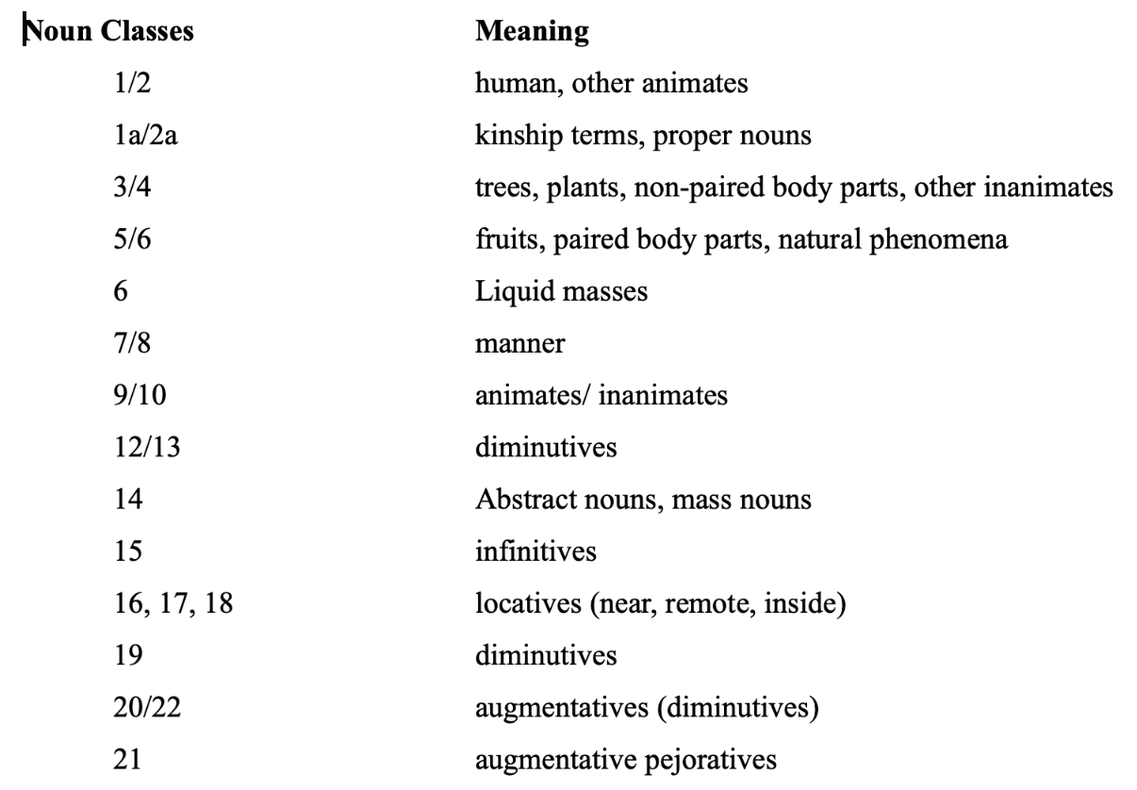
Traditional approaches to Bantu noun classes
The Proto-Bantu System
(Richardson, 1967; Welmers, 1973)

Slide 15
Traditional approaches to Bantu noun classes
Key features:
Classes marked by the prefix (rather than agreement) – problematic
Centred on semantics – problematic (lack of semantic regularity for some classes, several classes sharing semantic features)
Do not make use of any theory of productivity
Swahili (Carstens 1991)
(13) | kifaru | mdogo
 | 7.rhino | 1.small
Kîîtharaka (corpus data)
(14) | nkoma | ûyû
 | 9.devil | 1.this

Slide 16
Traditional approaches to Bantu noun classes
Key features:
Classes marked by the prefix (rather than agreement) – problematic
Centred on semantics – problematic (lack of semantic regularity for some classes, several classes sharing semantic features)
Do not make use of any theory of productivity
Swahili (Carstens 1991)
(13) | kifaru | mdogo
 | 7.rhino | 1.small
Kîîtharaka (corpus data)
(14) | nkoma | athi
 | 9.devil | 1.went

Slide 17
Traditional approaches to Bantu noun classes
The Proto-Bantu System
(Richardson, 1967; Welmers, 1973)
other animates
other inanimates
animates
inanimates
diminutives
diminutives
augmentatives
diminutives
augmentatives

Slide 18
Traditional approaches to Bantu noun classes
Key features:
Classes marked by the prefix (rather than agreement) – problematic
Centred on semantics – problematic (lack of semantic regularity for some classes, several classes sharing semantic features)
Do not make use of any theory of productivity
Swahili (Carstens 1991)
(13) | kifaru | mdogo
 | 7.rhino | 1.small
Kîîtharaka (corpus data)
(14) | nkoma | athi
 | 9.devil | 1.went

Slide 19
Theoretical and empirical questions…
How do we know what semantic or morphophonological cues are productive amidst such exceptions?
Do speakers treat different types of cues the same way? (e.g., Karmiloff-Smith, 1981; Perez-Pereira 1991; Gxilishe et al., 2009; Gagliardi & Lidz 2014 a.o)
Do traditional approaches to Bantu noun classes answer these questions?
Required:
A theory of productivity
Empirical evidence for speakers’ use of different cues.

Slide 20
Traditional approaches to Bantu noun classes
Are problematic
Class determined by prefix (not agreement) – Not always true
Semantically centred - some lack semantic regularity and others share features
No theory to show what makes a feature productive
No empirical evidence for speakers use of given features as cues to noun classification

Slide 21
A different approach to Kîîtharaka
The project aims to establish productive features that determine noun class membership in Kîîtharaka:
Corpus analyses using Tolerance Principle (Yang, 2016)- provides a way of establishing productivity of rules in a set of items with exceptions (exceptions should not exceed a certain threshold)
Psycholinguistic tests – shows what speakers pay attention to.
Includes testing the relative importance of semantic and morpho-phonological cues (following e.g., Karmiloff-Smith, 1981; Gagliardi & Lidz 2014, and others).

Slide 22
Building a Corpus
The study uses a corpus (2327 nouns)
901 collected from Kîîtharaka bible (published in 2019) and,
1426 translated from SIL comparative African Wordlist (Snider
and Roberts, 2006).
Translation of SIL list done to achieve a balanced corpus
Coded for singular/plural agreement, semantics and morphophonological features (prefixes).

Slide 23
Semantic features coded for
Expected Class | Semantic Feature(s)
1 | human
3 | Extended shape, spread shape, protruding shape, trees & plants, dispersive mass
5 | Fruits, round shape, plant part, augmentative, made of wood, cohesive mass
7 | Artefacts, pejorative, derived
9 | Animals, artefacts, loan (other)
11 | Narrow things, wavy-shaped things
12 | Diminutives
14 | Abstract, mass
15 | Derived, infinitives

Slide 24
Morphophonological features coded for
Morphophonological feature | Expected class
Mû- | 1
Mû- | 3
Î- | 5
Kî- | 7
N, ø | 9
Rû- | 11
Ka- | 12
Û- | 14
Kû- | 15

Slide 25
Corpus Analysis
Corpus analysed for rule productivity using Tolerance Principle (Yang, 2016)
Tolerance Principle demonstrates how to establish the productivity of rules with exceptions.
Proposed to account for how and when e.g., language learners make generalizations and when they don’t.
provides a threshold beyond which the exceptions should not exceed for the rule to be productive.
Makes use of 2 integer values N (number of items in the lexicon) and e (number of items not obeying the rule)
Let a rule be defined over a set of N items.
The rule is productive if the number of exceptions does not exceed a threshold, 𝛉_{N.}
exceptions (e) ≤ 𝛉_{N} (N/ln(N))

Slide 26
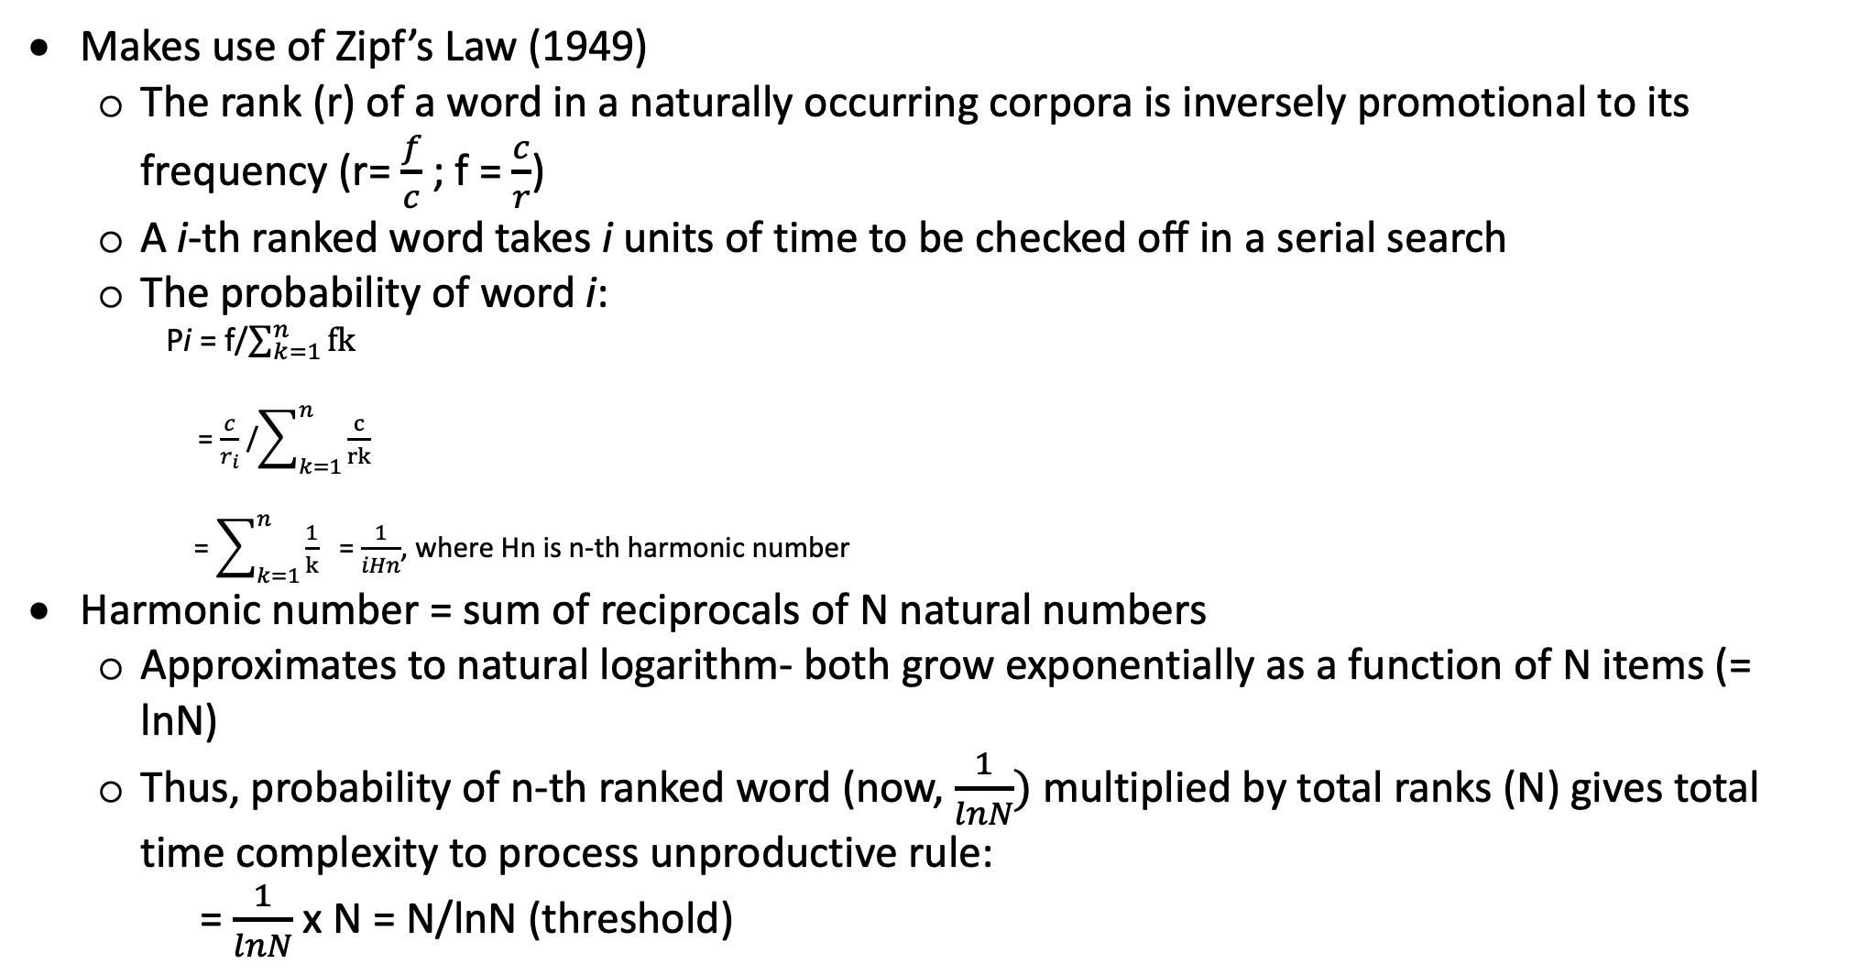
Derivation of Tolerance Principle
Makes use of Zipf’s Law (1949)
The rank (r) of a word in a naturally occurring corpora is inversely promotional to its frequency (r= $\frac{f}{c}$ ; f = $\frac{c}{r}$)
A i-th ranked word takes i units of time to be checked off in a serial search
The probability of word i:
Pi = f/$\sum_{k=1}^{n}{fk}$
= $\frac{c}{r_{i}}$ /$\sum_{k=1}^{n}{\frac{c}{rk}}$
= $\sum_{k=1}^{n}{\frac{1}{k}}$ = $\frac{1}{iHn}$, where Hn is n-th harmonic number
Harmonic number = sum of reciprocals of N natural numbers
Approximates to natural logarithm- both grow exponentially as a function of N items (= lnN)
Thus, probability of n-th ranked word (now, $\frac{1}{lnN})$multiplied by total ranks (N) gives total time complexity to process unproductive rule:
= $\frac{1}{lnN}$ x N = N/lnN (threshold)

Slide 27
Derivation of Tolerance Principle

Slide 28
Derivation of Tolerance Principle

Slide 29

Corpus Results

Slide 30
Results: a productive semantic feature for class 5
Rule: [+augmentative ] class 5
Semantic features | N | Class 5 | e | 𝛉_{N} | Productive?
Human | 252 | 2 | 250 | 46 | No
Augmentative | 32 | 25 | 7 | 9 | Yes
Round | 44 | 12 | 32 | 12 | No
Plant part | 47 | 6 | 41 | 12 | No
Fruit | 17 | 8 | 9 | 6 | No
Made from wood | 12 | 1 | 11 | 5 | No
Derived | 1081 | 40 | 1041 | 155 | No
Cohesive mass | 58 | 5 | 53 | 14 | No

Slide 31
Corpus results: productive semantic features (overall)
[+augmentative] class 5
[+pejorative] class 7
[+diminutive] class 12
[+derived] class 15
[+infinitive] class 15

Slide 32

Results: productive semantic features
What about [+Human] feature!

Slide 33
Results: a productive semantic feature (class-feature mapping)
Class | Human | N | e | 𝛉_{N} | Productive?
1 | 198 | 198 | 0 | 37 | Yes
3 | 4 | 223 | 219 | 41 | No
5 | 2 | 177 | 175 | 34 | No
7 | 21 | 262 | 241 | 47 | No
9 | 22 | 428 | 406 | 71 | No
11 | 0 | 120 | 120 | 25 | No
12 | 6 | 81 | 75 | 18 | No
14 | 0 | 105 | 105 | 23 | No
15 | 0 | 684 | 684 | 105 | No

Slide 34
Results: a productive morphophonological feature
Rule: [+kî-] class 7
Morpho-phonological features | N | Class 7 | e | 𝛉_{N} | Productive?
mû- | 397 | 0 | 397 | 66 | No
rû- | 122 | 0 | 122 | 25 | No
kî- | 268 | 262 | 6 | 48 | Yes
ri- | 5 | 0 | 5 | 3 | No
kû- | 677 | 0 | 677 | 104 | No
û- | 107 | 0 | 107 | 23 | No
î- | 188 | 0 | 188 | 36 | No
ka | 82 | 0 | 82 | 19 | No
n- | 329 | 0 | 329 | 57 | No

Slide 35
Results: productive morphophonological features
[+î-/rî-] class 5
[+kî-] class 7
[+n-] class 9
[ø-] class 9
[+rû-] class 11
[+ka-] class 12
[+û-] class 14
[+kû-] class 15

Slide 36
Corpus results: productive morphophonological features
[+Mû-] is not productive!

Slide 37
Are [+human] and [+mû-] really unproductive?
A possible case of interaction with other features
A need for recursive application of Tolerance Principle
Sub-divide the lexicon into logical subset, reapply the rule

Slide 38
Are [+human] and [+mû-] really unproductive?
The corpus used?
Wrong predictions by Tolerance Principle?
A robust theory can fail (indeed “all grammars leak” Sapir (1921)
But should seemingly robust grammars leak?
How features were defined (non-binary/independent)
With binary features, we can subset the lexicon for a recursive application of Tolerance Principle
Possible rules based on subsets:
[+human, -pejorative] class 1(semantic)
[+human, +pejorative] class 7
[+mû, +human] class 1 (morphophonology + sematics)
[+mû-, -human] class 3 ”
Recursive application yields!

Slide 39
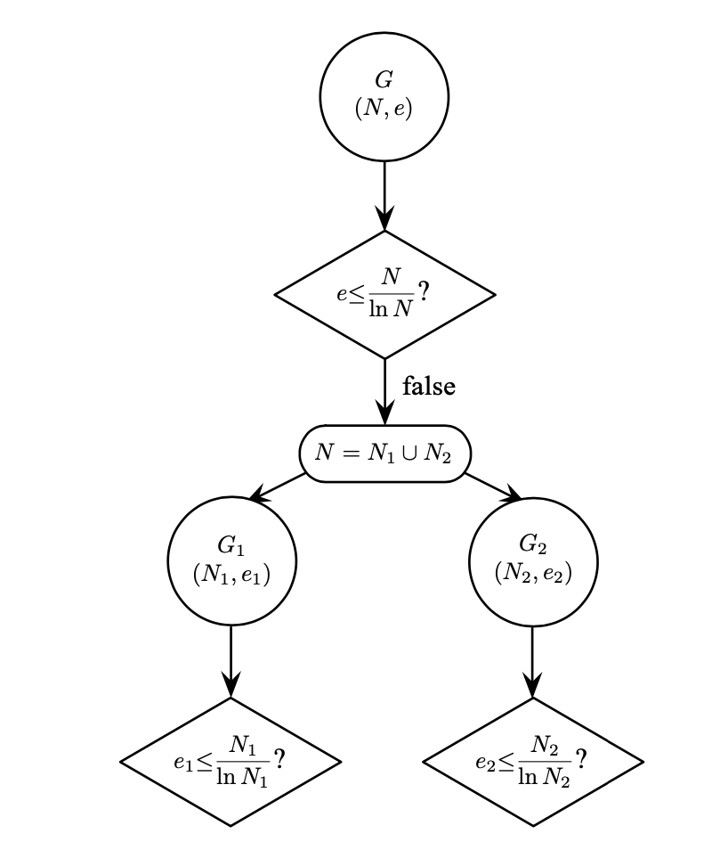
A model of recursive application of Tolerance Principle
Yang, 2016:104

Slide 40
Are [+human] and [+mû-] really unproductive?
Possible rules based on subsets:
[+human, -pejorative] class 1(semantic)
[+human, +pejorative] class 7 ”
[+mû, +human] class 1 (morphophonology + sematics)
[+mû-, -human] class 3 ”

Slide 41
Are [+human] and [+mû-] really unproductive?
The corpus used?
Wrong predictions by Tolerance Principle?
A robust theory can fail (indeed “all grammars leak” Sapir (1921)
But should seemingly robust grammars leak?
How features were defined (non-binary/independent)
With binary features, we can subset the lexicon for a recursive application of Tolerance Principle
Possible rules based on subsets:
[+human, -pejorative] class 1(semantic)
[+human, +pejorative] class 7 ”
[+mû, +human] class 1 (morphophonology + sematics)
[+mû-, -human] class 3 ”

Slide 42
Results: a productive semantic rule (recursive appl.)
Rule: [+human, -pejorative] Class 1
Semantic features | N | Class 1 | e | 𝛉_{N} | Productive?
Human | 252 | 197 | 52 | 46 | No
[+human, -Pejorative] | 235 | 197 | 38 | 43 | Yes
Recursive application yields!

Slide 43
Results: a productive morphophonological rule
Rule: +mû- [+human] Class 1
Hybrid features | N | Class 1 | e | 𝛉_{N} | Productive?
mû- | 397 | 162 | 235 | 66 | No
[+mû-, +human] | 166 | 162 | 4 | 32 | Yes
Rule: +[+mû-, -human] Class 3
Hybrid features | N | Class 3 | e | 𝛉_{N} | Productive?
mû- | 235 | 235 | 162 | 66 | No
[+mû-, -human] | 235 | 235 | 0 | 43 | Yes

Slide 44
A possible schema
 |  | Thing (most prototypical)
[+Evaluative] |  |  |  | [-Evaluative]
Augmentative
Pejorative |  |  | [+Human ] |  | [-human]
Diminutive |  |  | (semantics) |  | (morphophonology)

Slide 45

Experiments: Observation of human behaviour
Test to what extent statistical measure of productivity reflects speakers’ own usage
3 experiments (two done)
30 native speakers (males & females; age 18—45)

Slide 46
Experiment 1: Semantic features tested
Semantic Feature | Expected Class
Human | 1
Extended | 3
Augmentative | 5
Fruits | 5
Artefacts | 7
Pejorative | 7
loan (other) | 9
Narrow | 11
Wavy | 11
Diminutive | 12

Slide 47
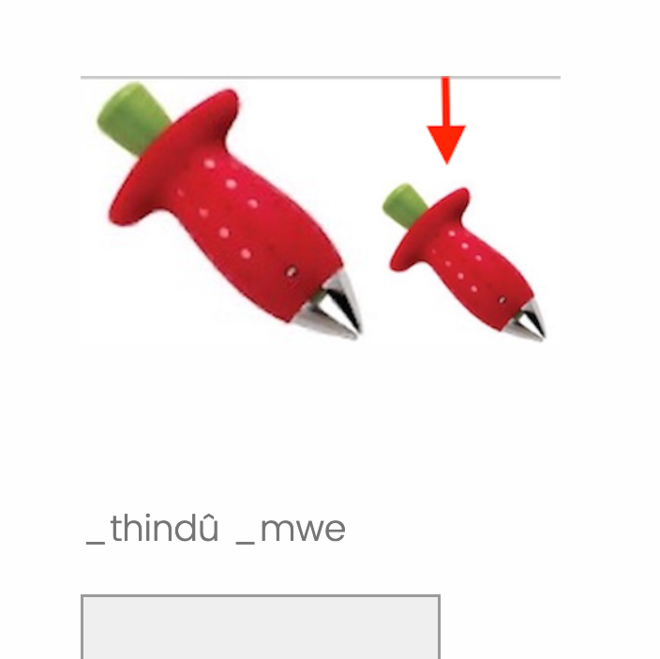
Stimuli
Participants saw an unfamiliar image followed by a DP(novel noun> num) with an underscore at the beginning of each word
Required to use their Kîîtharaka knowledge to judge if part of the words were missing and type them in full.
Order in which the stimuli appeared and image-DP pairing randomized across participants
Each feature tested 3 times, 30 images, 30 novel nouns

Slide 48
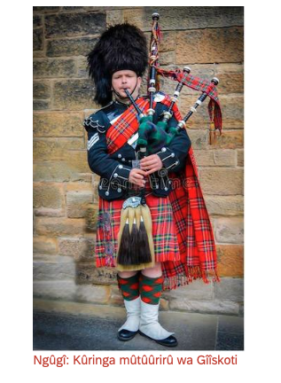

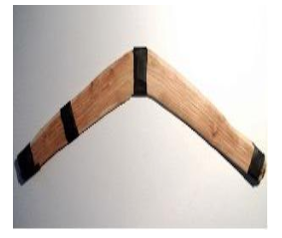
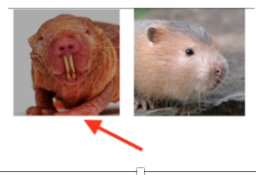
Sample stimuli images

Slide 49
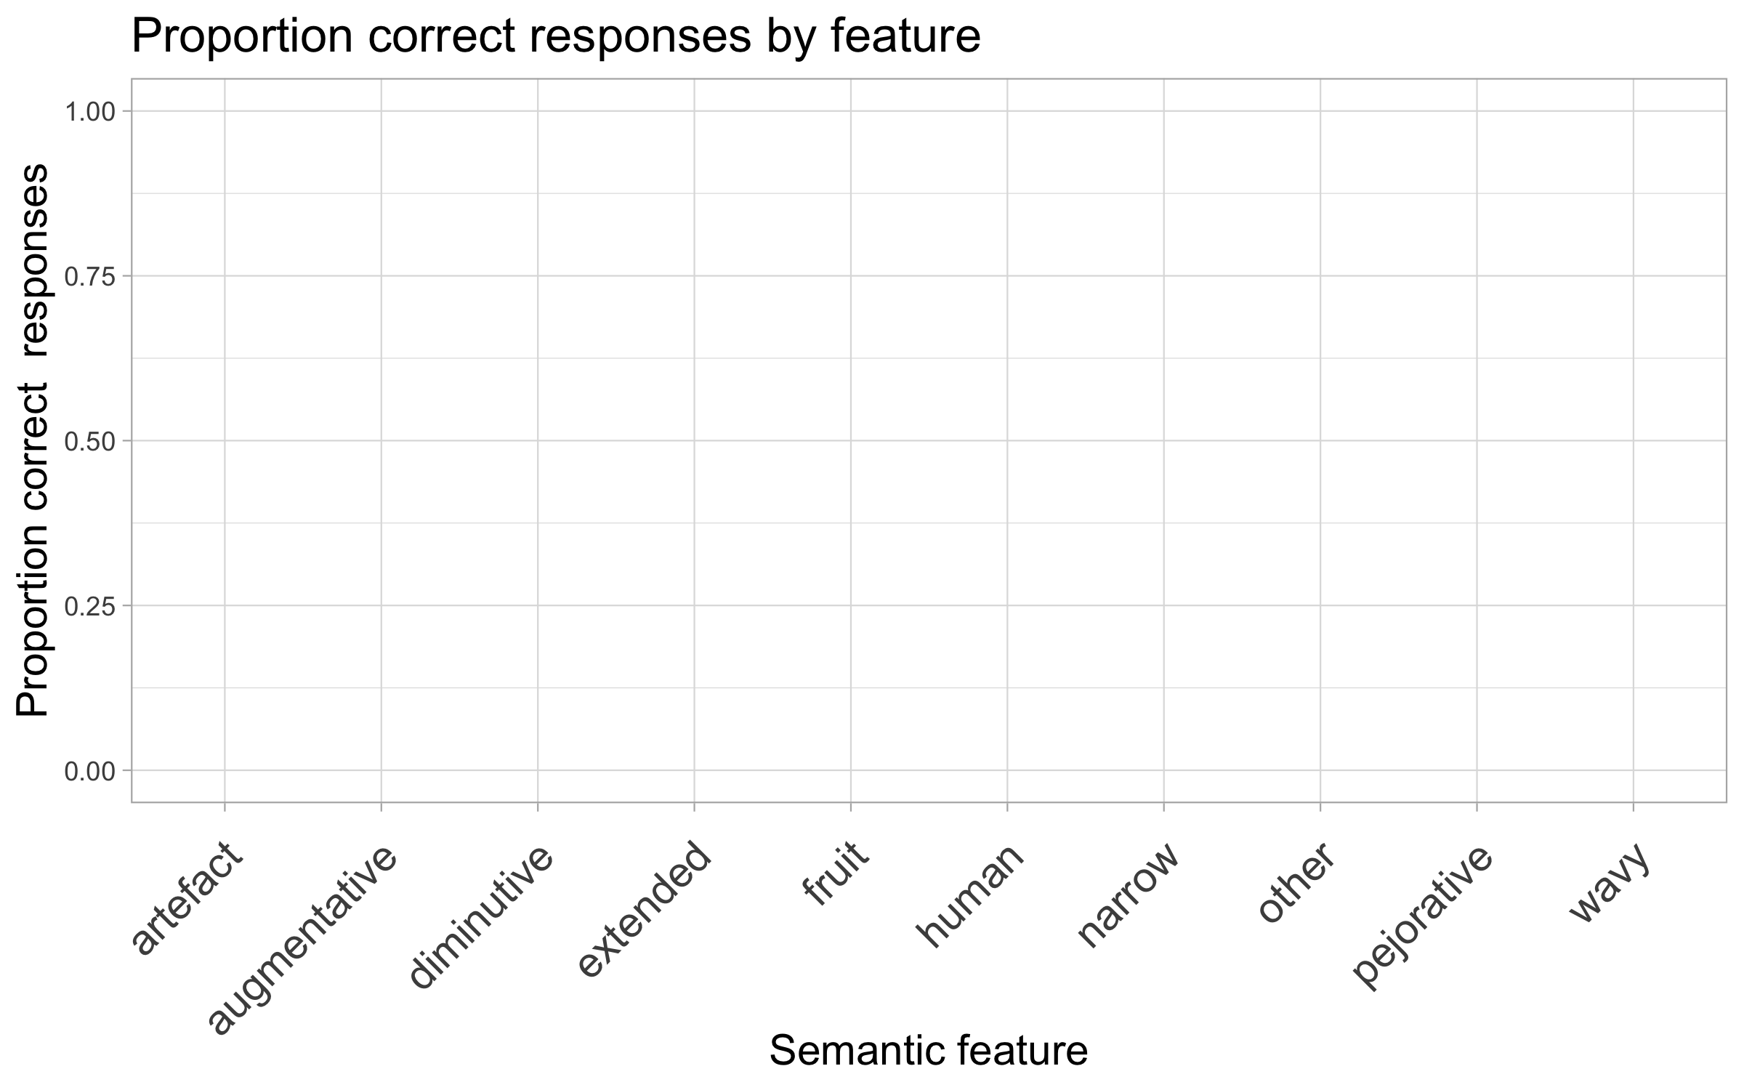
Experiment 1 results: productive semantic features

Slide 50
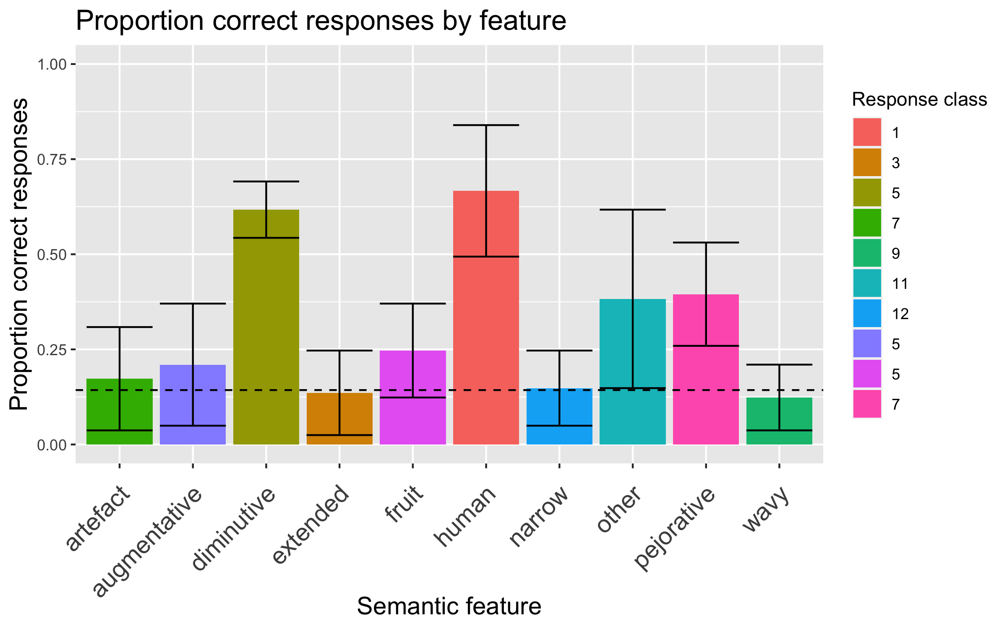
Experiment 1 results: productive semantic features

Slide 51
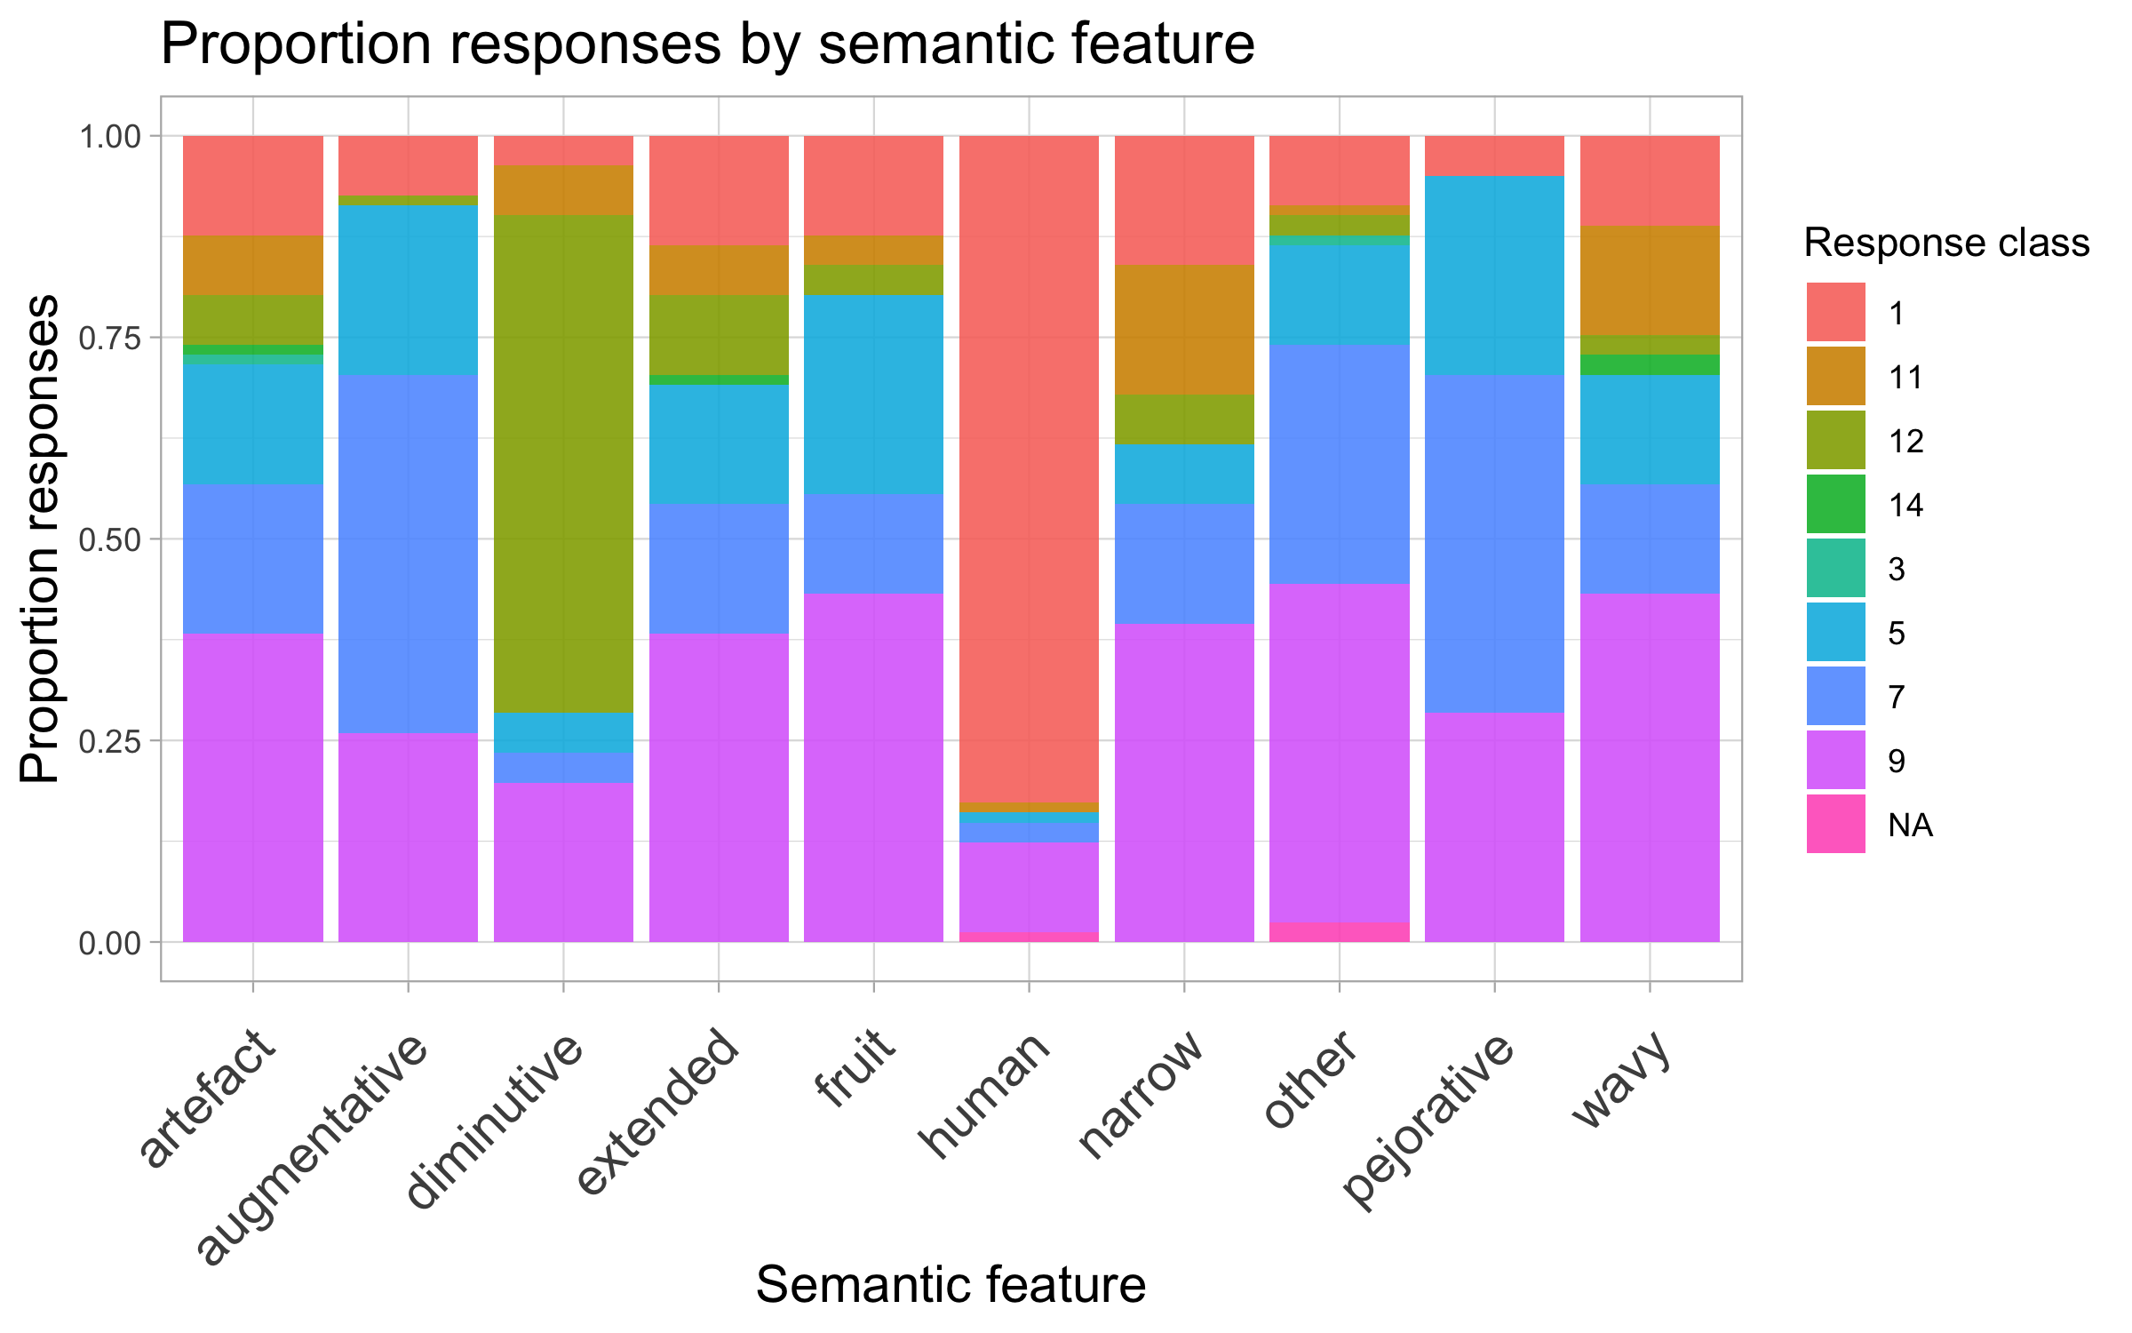

Experiment 1 results: productive semantic features

Slide 52
Does Experiment 1 confirm TP predictions?
The experimental results largely mirrors the the TP predictions:
¾ features predicted by TP are productive.
Augmentative unproductive in the experiment
Productivity of ‘other’ at chance in the experiment (was unproductive in the corpus)

Slide 53
Experiment 1 results: What’s up with augmentative?
Evaluative features expected to be productive (see, Castagneto 2017, Msaka 2019)
The unproductivity of augmentative thus surprising!
Possible causes:
Task related?

Slide 54
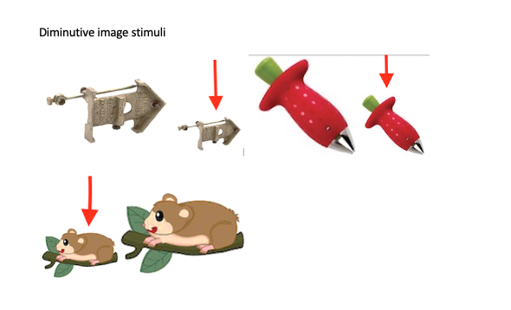
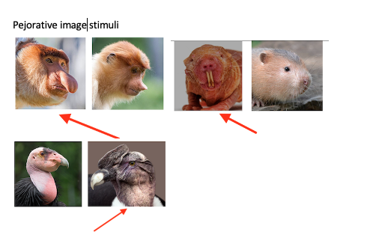
Experiment 1: image stimuli

Slide 55
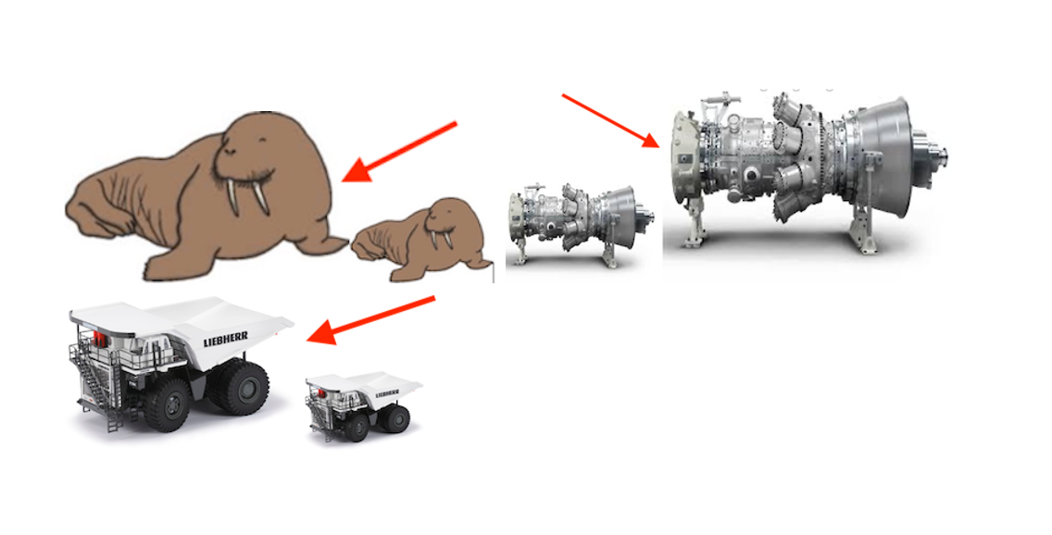
Experiment 2: Image Stimuli
Augmentative image stimuli

Slide 56
Experiment 1 results: What’s up with augmentative?
A possible merger in augmentative and pejorative encoding?
Evidence from speaker’s lexicon show the morphemes associated with augmentation and pejoration may be used interchangeably:
Îrori/ kîrori “a lorry”
Îrinya/kîrinya “a big hole/ditch”
Îthoka/kîthoka “ an axe”
The two are also used to express disdainful tone:
Îmuntû/kîmuntû rîrî “this bad person’

Slide 57
Experiment 1 results: What’s up with augmentative?

Slide 58
Experiment 2: Morphophonological features tested
Prefix-agreement pairing tested in three levels:
Singular prefix – singular agreement
Plural prefix – Plural agreement
Singular prefix – Plural noun + agreement
Participants (30 native speakers, age 18-45)

Slide 59
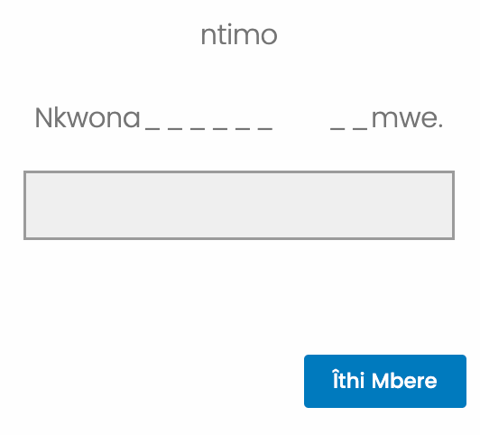
Stimuli
Participants saw a (non)prefixed novel noun followed by a short sentence with two gaps, as in Nkwona ____ _mwe “I have seen _one ____”.
Required to fill in the gaps using the noun seen and its agreement

Slide 60
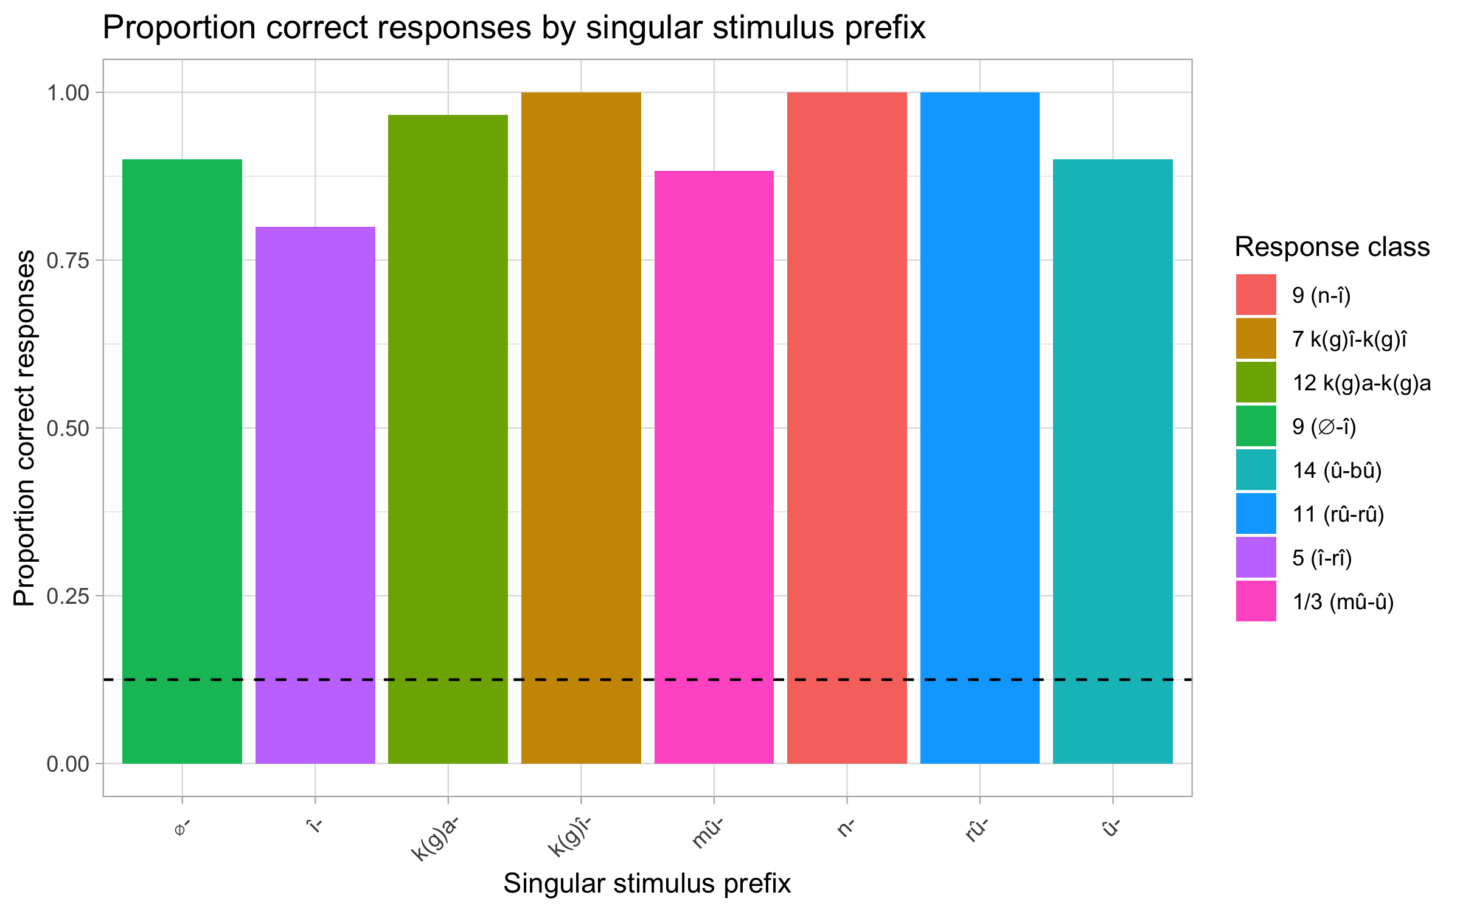
Results: productive morphophonological features
singular stimulus – singular agreement (class)

Slide 61
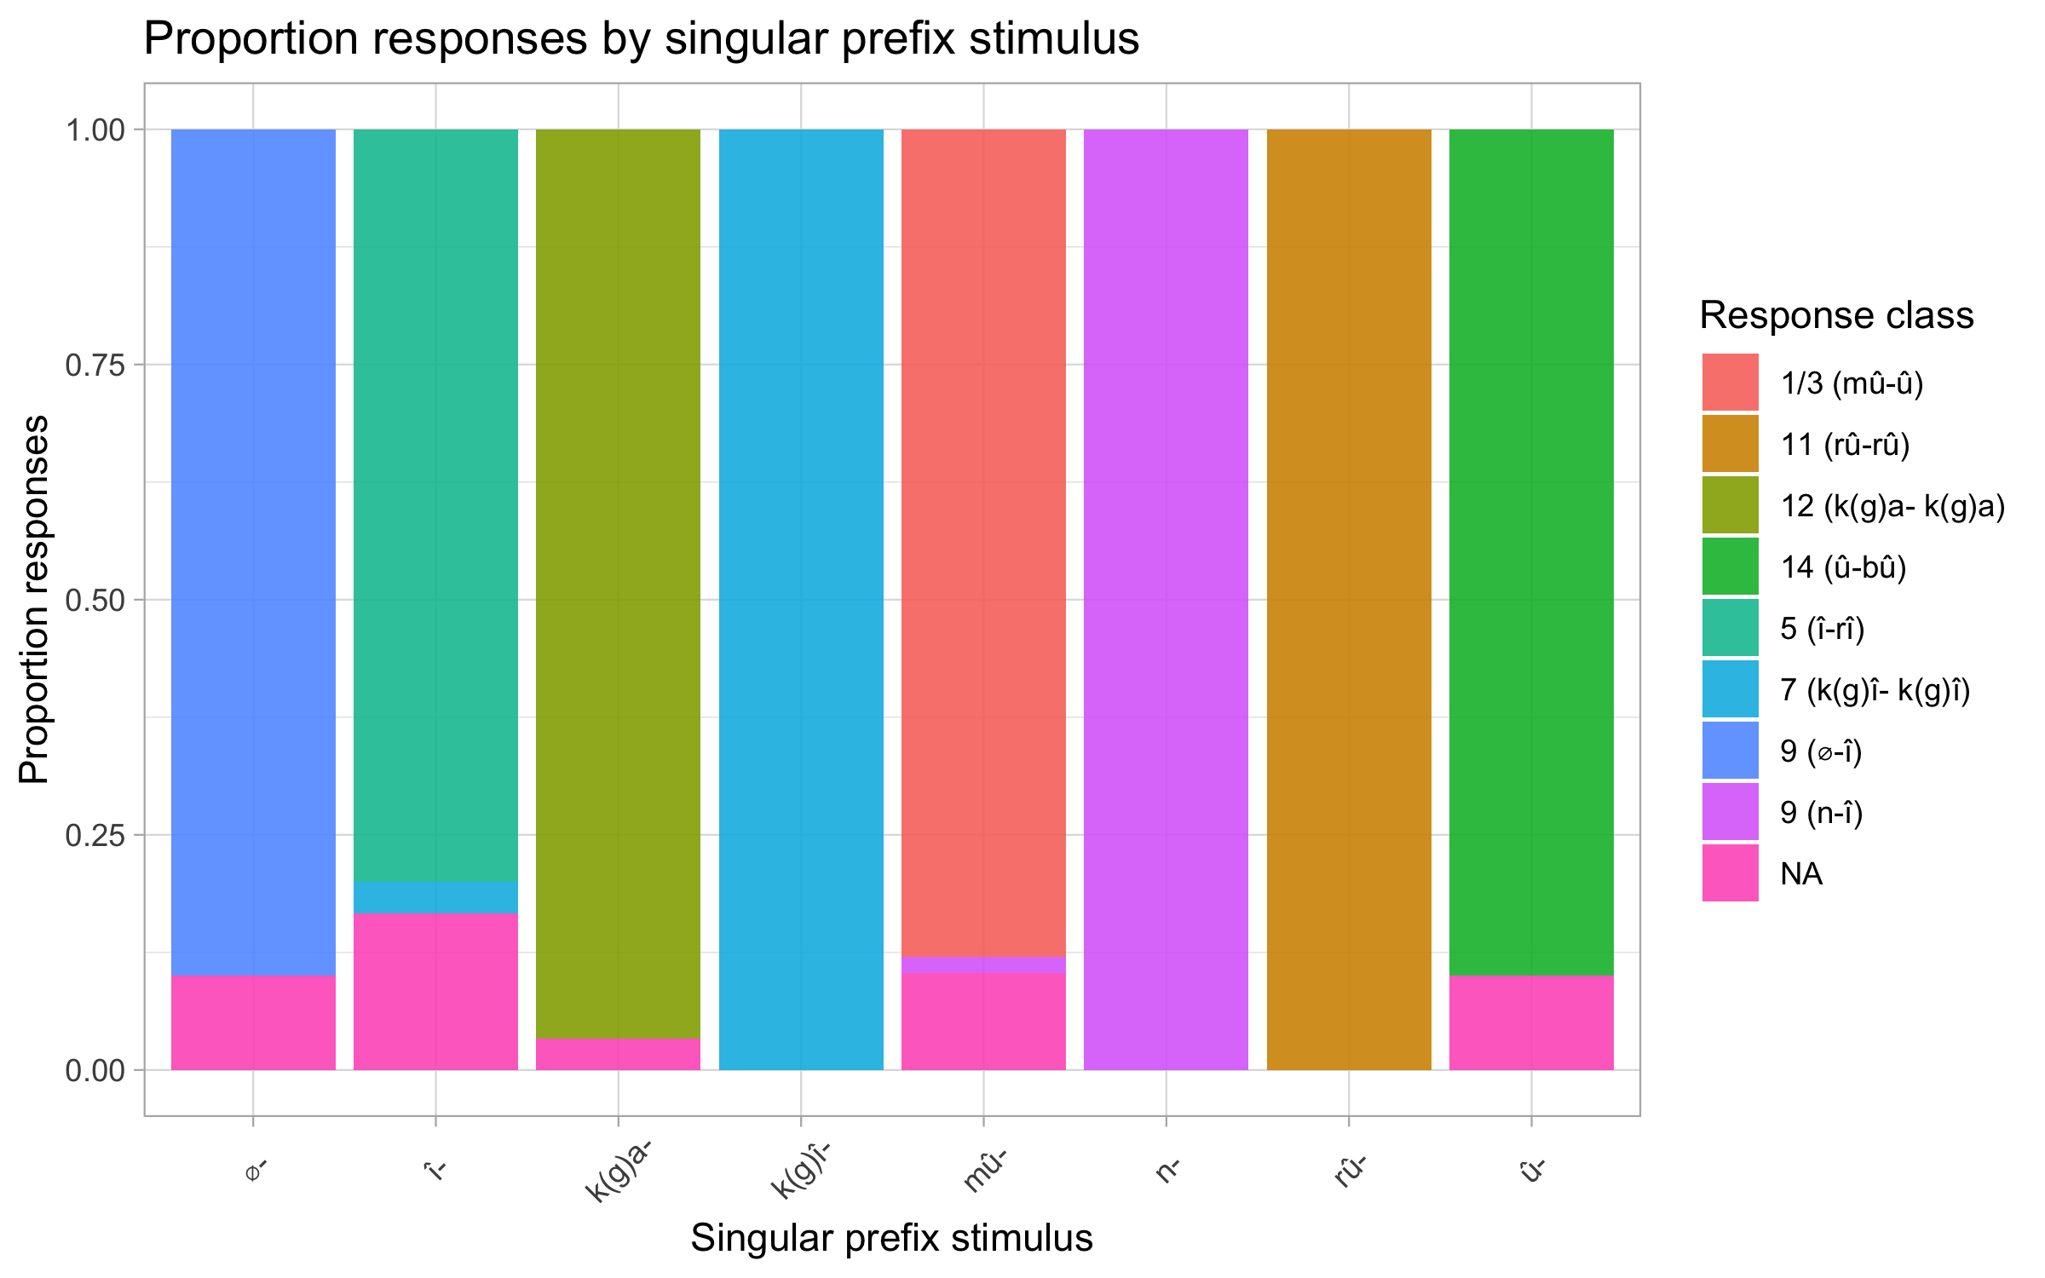
Results: productive morphophonological features
singular stimulus – singular agreement (class)

Slide 62
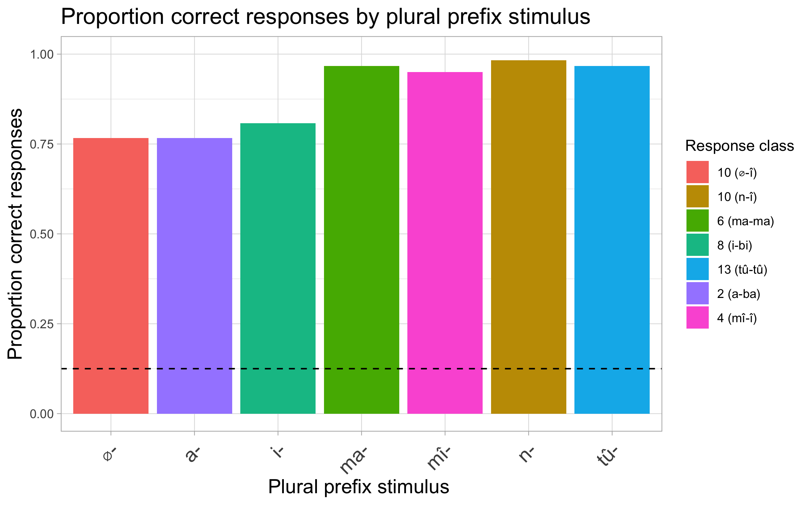
Results: productive morphophonological features
plural stimulus – plural agreement (class)

Slide 63
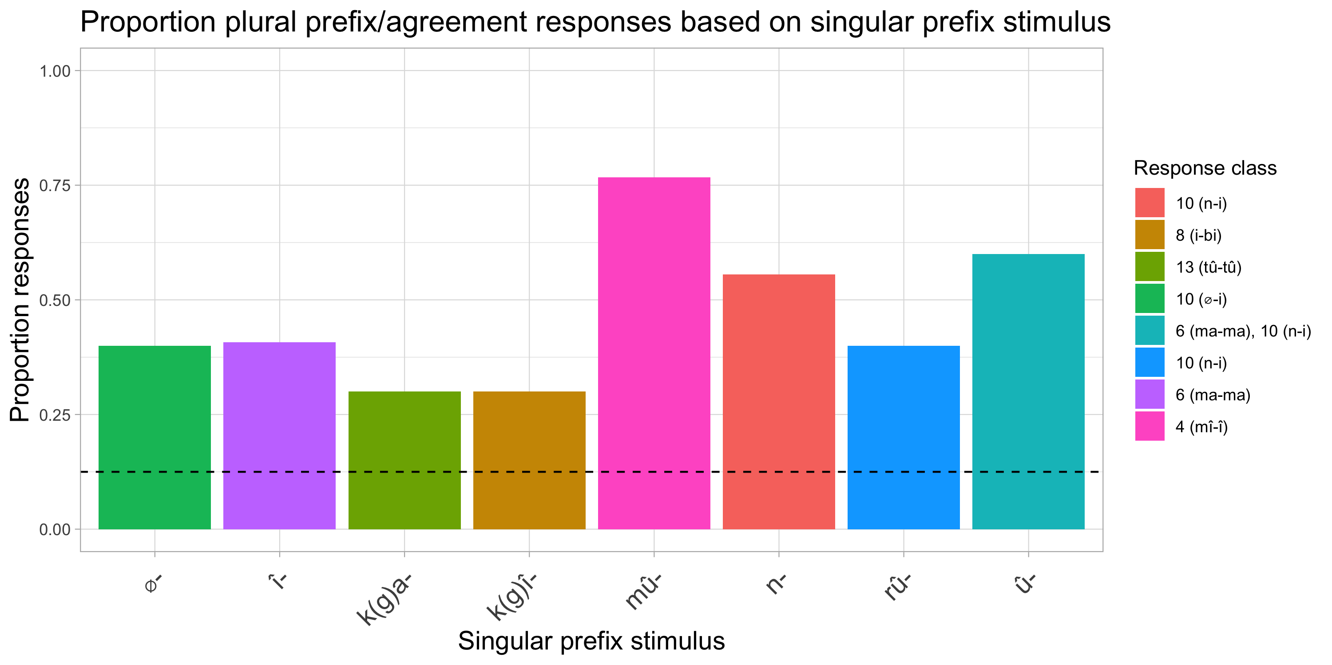
Results: productive morphophonological features
singular stimulus – plural agreement (class)

Slide 64
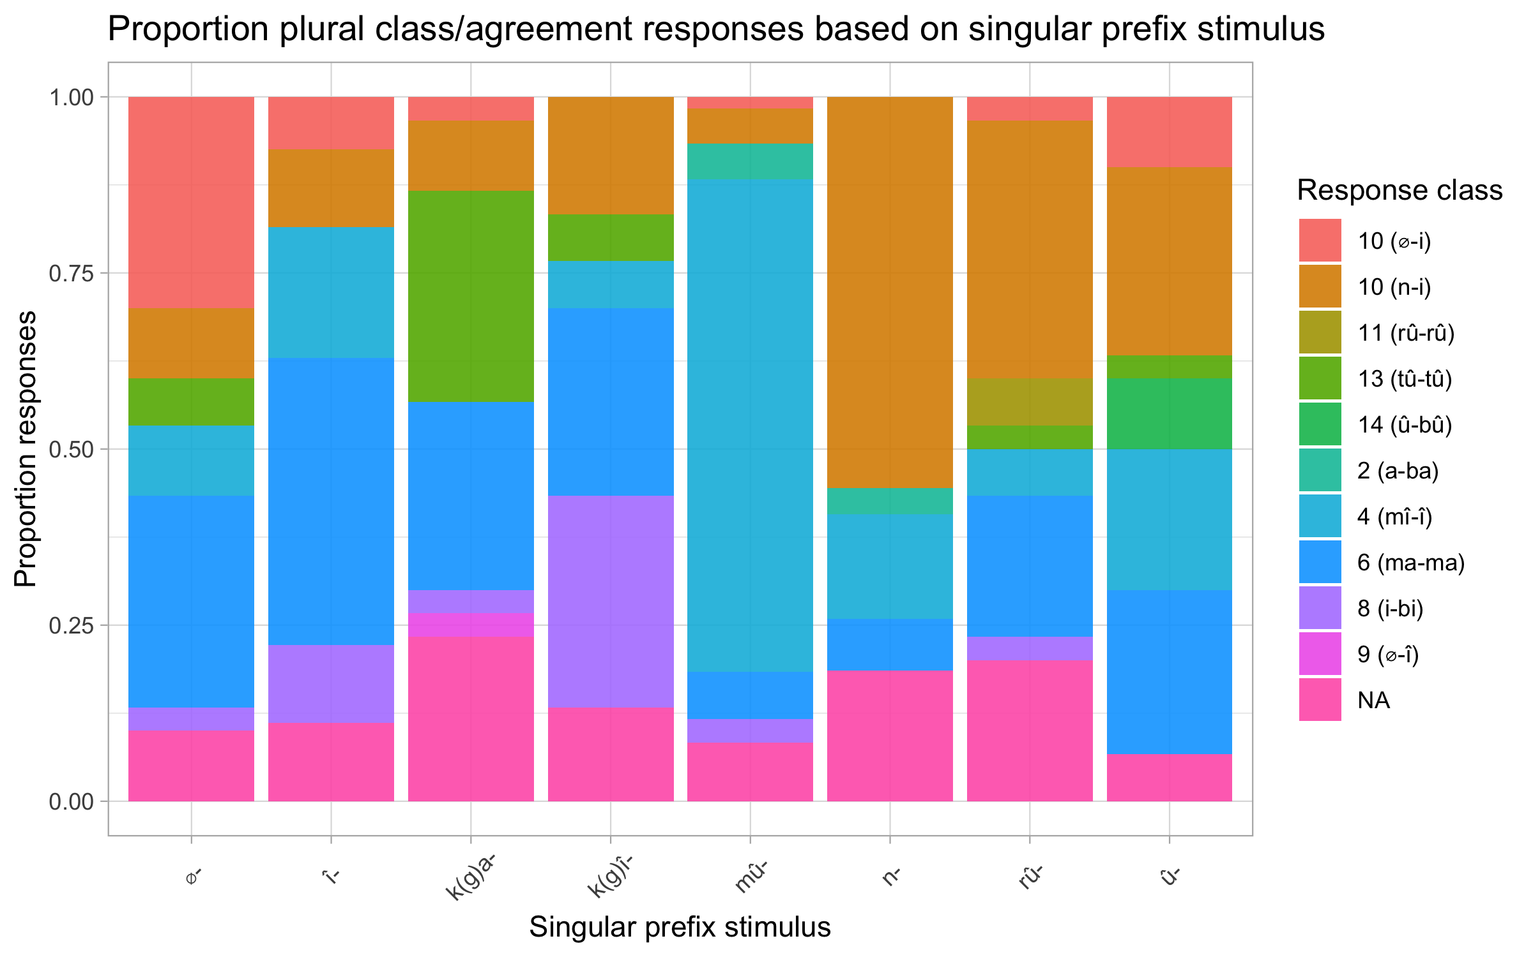
Results: productive morphophonological features
singular stimulus – plural agreement (class)

Slide 65
Results: productive morphophonological features
singular stimulus – plural agreement (class)
NA:
Impossible prefix –agr pairing (few)
or incomplete:
Ntagi îthatû
Nciira

Slide 66
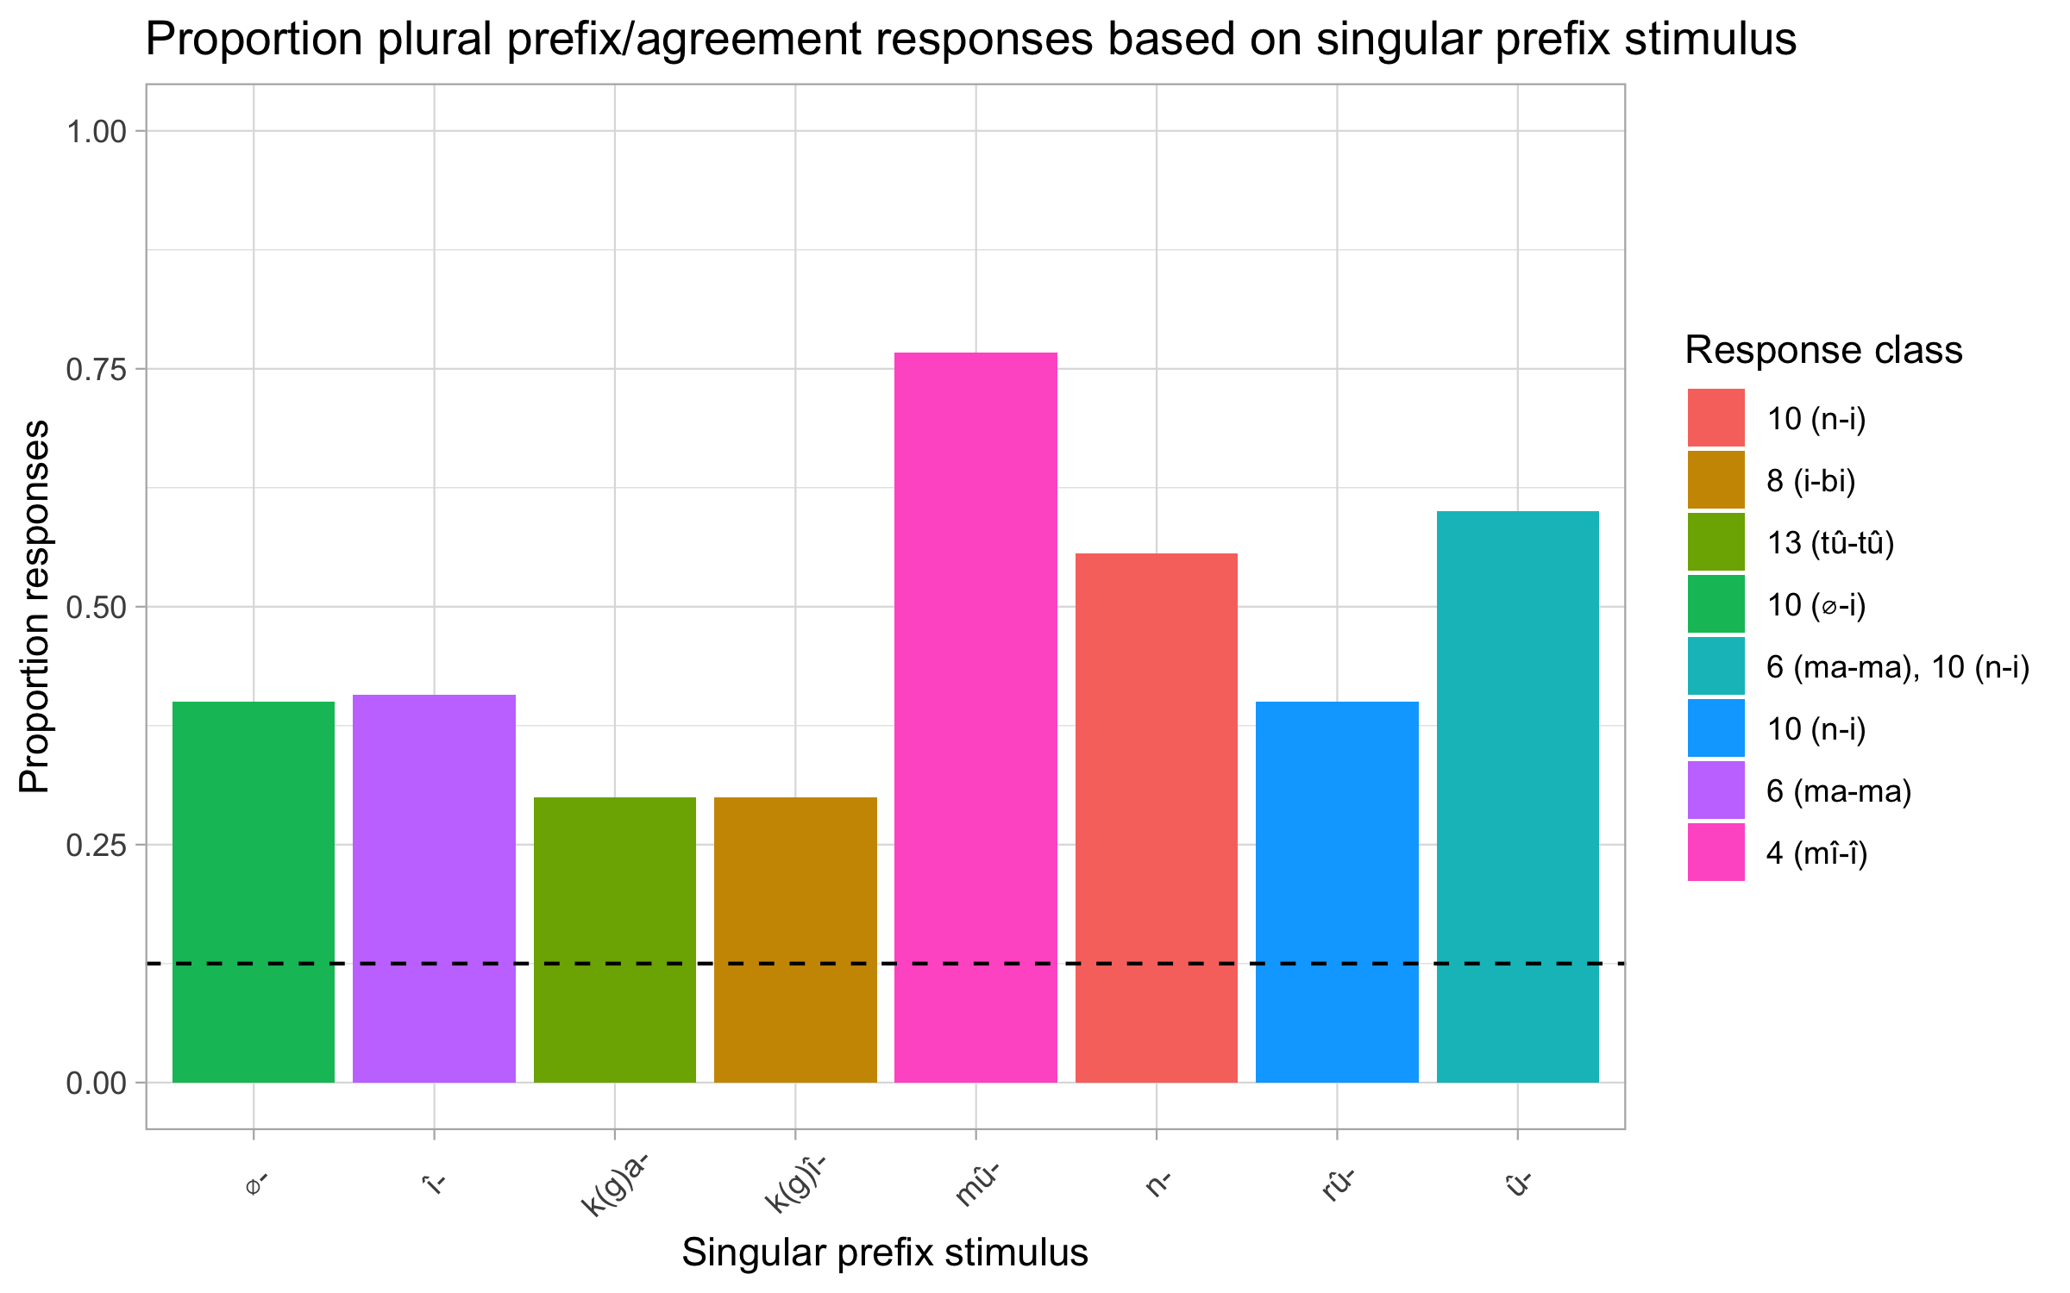
Results: productive morphophonological features
singular stimulus – plural agreement (class)

Slide 67
Does Experiment 2 confirm TP predictions?
All prefixes productive in the corpus also productive in the experiment
The mû- prefix is interesting–only productive for class 3
Prefix underspecified– but why is it overwhelmingly productive for class 3?
Could be a default morphophonological rule that applies in the absence of semantic specification

Slide 68
Implications
A theory of productivity is instrumental in establishing which features productively determine nominal (gender) agreement
Experimental results reflect TP based results to a greater extent.
Both semantics and formal features are necessary cues to class in Kîîtharaka
Semantics- human–nonhuman distinction (class 1/2 vs others); evaluation (class 5, 7, 12)
Morphophonology- applies productively for all non-human non-evaluative classes
Singular-plural class mapping somewhat regular in 1/3, 9 and 14 and less of it in other classes (level 3 exp. 2) – interesting?

Slide 69
Implication: a possible schema
 |  | Thing (most prototypical)
[+Evaluative] |  |  |  | [-Evaluative]
Augmentative (î - ma)
Pejorative (k(g)î - bi) Diminutive (k(g)a-k(g)a |  |  | [+Human ] û - ba (1/2) |  | [-human] Morphophonological rules
 |  |  |  |  | û - î (3/4)
 |  |  |  |  | î - ma (5/6)
 |  |  |  |  | k(g)î-bî (7/8)
 |  |  |  |  | î - i (9/10)
 |  |  |  |  | k(g)a - tû (12/13)
 |  |  |  |  | û – bû (14)
 |  |  |  |  | k(g)û – k(g)û (15)
 |  |  |  |  | a - g(k)û (16,17)

Slide 70
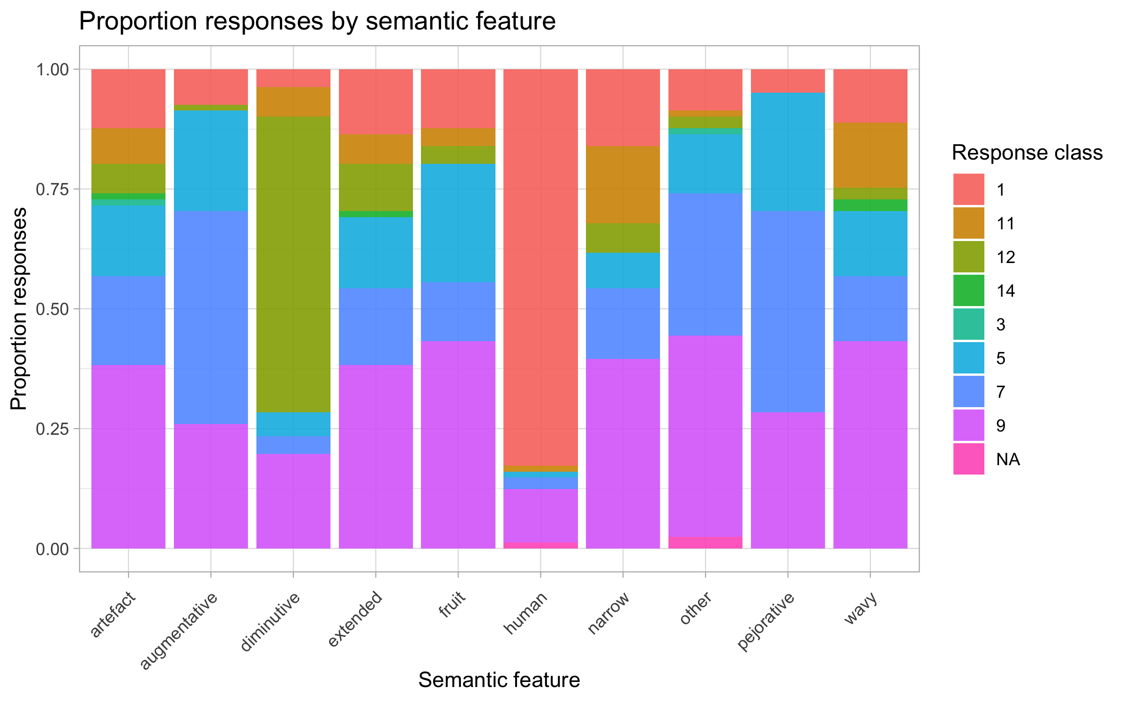
Implications: a merger of î- and k(g)î in meaning?

Slide 71
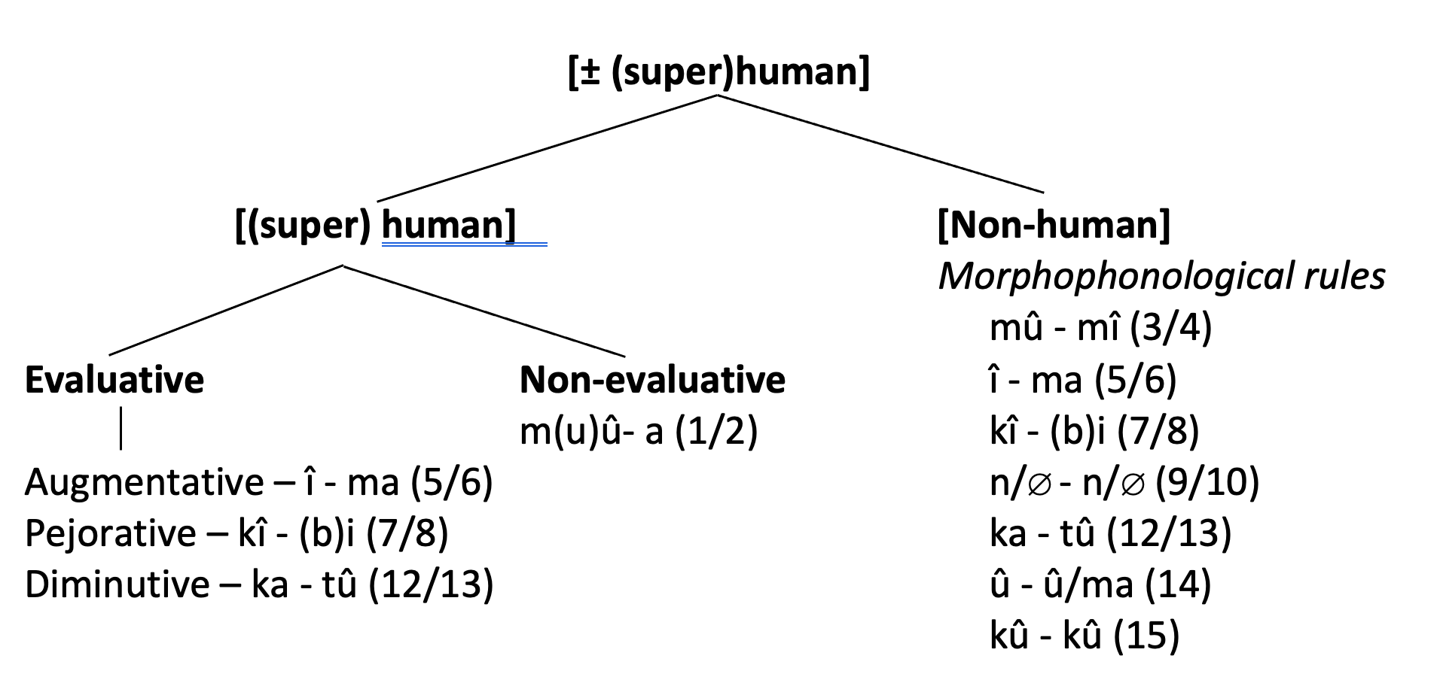
Implications: a possible schema
n – n (9/10)

Slide 72
Next steps
Establish relative importance of semantic & morphophonology (experiment 3)
Provide stimuli with conflicting semantic and morphophological cues
(following; Karmiloff-Smith, 1981; Gagliardi & Lidz 2014, and others).

Slide 73
The End
Thank you!

Slide 74
References
Aikhenvald, A. (2003). Classifiers: A typology of noun categorization devices. Oxford: Oxford University Press.
Amidu, A.A. 1997. Classes in Kiswahili. Köln: Rüdiger Köppe Verlag.
Bible Translation & Literacy (EA). (2019). Bibiria: Kîrîîkanîro kîra gîkûrû na kîrîîkanîro kîra kîyerû. Nairobi: Bible Translation & Literacy (EA).
Bleek, W.H.I. (1862-1969). A Comparative Grammar of South African Languages, I: Phonology (1862), II: The Concord, section I: The Noun (1869). London: Trubner. (Republished 1971 in one volume, Farnborough: Gregg.)
Brooks, P. J., Braine, M. D., Catalano, L., Brody, R. E., & Sudhalter, V. (1993). Acquisition of gender-like noun subclasses in an artificial language: The contribution of phonological markers to learning. Journal of Memory and Language, 32, 76–95.
Carstens, V., (1991). The morphology and syntax of determiner phrases in Kiswahili. UCLA PhD thesis.
Corbett, G.G. 1991. Gender. Cambridge Mass.: Cambridge University Press.
Demuth, K. (1992). Acquisition of Sesotho. In Slobin, D. (Ed.), The cross-linguistic study of language acquisition (Vol. 3, pp. 557–638). Hillsdale, NJ: Lawrence Erlbaum.
Demuth, K. (1994). On the ‘underspecification’ of functional categories in early grammars. In Lust, B., Suñer, M., Whitman, J. (Eds.), Syntactic theory and first language acquisition: Cross-linguistic perspectives (pp. 119–134). Hillsdale, NJ: Lawrence Erlbaum.
Demuth, K. (2000). Bantu noun class system: Loan words and acquisition. (G. Senft, Ed.) Classification Systems, 270-292.
Demuth, K., & Ellis, D. (2008). Revisiting the acquisition of Sesotho noun class prefixes. Mahwah, NJ: Lawrence Erlbaum.
Denny, J.P. & Creider, C.A. 1986. The semantics of noun classes in Proto-Bantu. In Noun classes and categorization. C. Craig, Ed. Amsterdam/ Philadelphia: John Benjamins Publishing Company.
Desrochers, A., Paivio, A., & Desrochers, S. (1989). L’effet de la fréquence d’usage des noms inanimés et de la valeur prédictive de leur terminaison sur l’identification du genre grammatical. Revue Canadienne de Psychologie, 43, 62–73.
Dixon, R. (1986). Noun classes and noun classification in typological perspective. In C. G. Craig (Ed.), Noun classes and categorization (pp. 105–112). Philadelphia, PA: John Benjamins.
Eberhard, David M, F. Simons and Charles, D. (2019). Kîîtharaka. (Fennigh, Ed.) Retrieved 09 28, 2019, from Ethnologue: Languages of the World: http://www.ethnologue.com
Frigo, L., & McDonald, J. (1998). Properties of phonological markers that affect the acquisition of gender-like subclasses. Journal of Memory and Language, 39, 218–245.
Gagliardi, A. and Lidz, J. (2014). Statistical insensitivity in the acquisition of Tsez noun classes. Language, 90(1):58–89..
Givón, T. (1971b). Historical syntax and synchronic morphology: an archaeologist's field trip. CLS. 7:394–415.
Guthrie, Malcolm (1967–71) Comparative Bantu: an introduction to the comparative linguistics and prehistory of the Bantu languages. 4 vols. Farnborough: Gregg Press.
Hockett, C. F. (1958) A Course in Modern Linguistics. New York: Macmillan. 1966. What Algonquian is really like. International Journal of American Linguistics 32:59-73
Msaka, P.(2019) Nominal classification in bantu revisited: The perspective from Chichewa. PhD dissertation: Stellenbosch University. Available at: http://hdl.handle.net/10019.1/107220

Slide 75
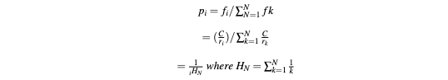

Derivation of the Tolerance Principle
TP assumes that the distribution of lexical items follow Zipf’s law (Zipf, 1949):
The rank (r) of a word in a naturally occurring corpora is inversely proportional to its frequency. Using this assumption, we can calculate the probability of a random ranked word, thus:
(Yang, 2018:2)
For a non-productive rule (T(N, N)), rank = r = r units of time, hence:
Sum probability =

Slide 76
Results: unproductive semantic rules
If [+(super)human Class 1
If [+animal] class 3, 5, 7, 9, 11
If [+plant part] class 5, 11
If [+wooden] class 5
If [+narrow] class 11
If [+wavy] class 11
If [+ artefacts] class 7
If [+protruding] class 3
If [+dispersive mass] class 3
If [+cohesive mass] class 5

Slide 77
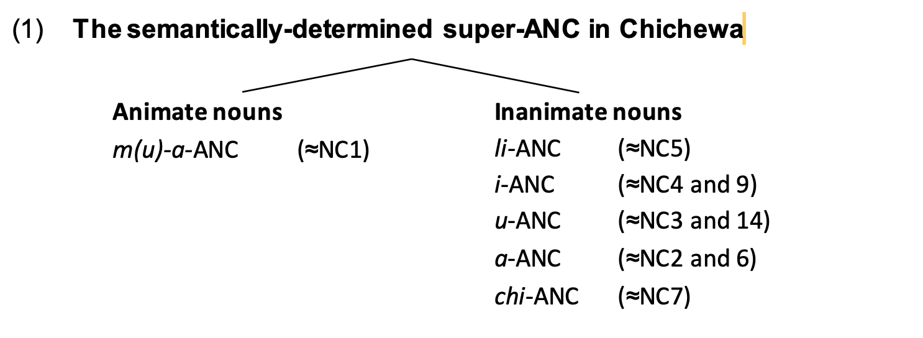
Implications: comparison with Chichewa
Two super-agreement noun classes (Msaka, 2019)
a) human/animate/agentive ~ animate
b) non-human/inanimate/non-agentive ~ inanimate

Slide 78
Corpus limitations
Limited variety of written Kîîtharaka text- relied on Kîîtharaka bible (BTL, 2019)
Bible lacks diversity on some semantic domains (e.g., names of local trees, local animals, body parts etc)
Translated SIL comparative African word list (Snider & Roberts, 2006)
Tolerance Principle give us predictions of human behaviour
Need for confirmation through experimenting with Kîîtharaka speakers

Slide 79
Next steps: psycholinguistic experiments
Goals:
Test TP predictions
What semantic and morpho-phonological rules are speakers sensitive to when classifying novel nouns?
What is the relative importance of semantic and morpho-phonological cues?
Results of similar experiments outside Bantu: children learning noun classes prefer phonology cues even when statistically less reliable than semantic cues (as in Karmiloff-Smith, 1981; Gagliardi & Lidz, 2014 a.o.)

Slide 80
Conclusion
Noun classes are hard to understand…
If approached from a diachronically centric point of view
Without a theory of productivity, and without empirical evidence from speakers
A new approach that makes use of data from synchronic corpus and observation of human behaviour can help us better understand Kîîtharaka (Bantu) noun classes

Slide 81
An overview of Tolerance Principle (TP)
TP offers a mechanism of establishing the productivity of linguistic rules in a set of items with exceptions by providing a threshold beyond which the exceptions should not exceed for the rule to be productive.
Let rule R be defined over a set of N items. R is productive if and only if e the number of exceptions does not exceed 𝛉_{N.}
(e ≤ 𝛉_{N} = N/ln(N) (Yang, 2016)
The threshold (Theta_N) is an expression of the time complexity involved in processing all the items in a non-productive rule. e.g, in a list of 100 items with 10 exceptions, the time taken is expressed as:
Productive rule = T (N, e) = T(100, 10)
Unproductive rule= T(N,N) = T(100, 100) (takes more time- each item is accessed and listed)
TP borrows substantially from two previous theories:
The Elsewhere Condition (Anderson, 1969; Aronoff, 1976)
Exceptions are processed earlier than regulars
Serial search- frequency sensitive (Stermberg, 1969; Forster, 1976)
Zipf’s Law (Zipf, 1949)
Yang uses it to derive the tolerance threshold (A function of probability and time needed to access all items in a non-productive rule)
The law states: The rank (r_{i}) and the frequency (f_{i}) of a word (w_{i}) in a corpus of natural language are inversely proportional (r_{i}f_{i} = C).

Slide 82
Experiment 1: Semantic Cues
Goal:
Determine what semantic rules speakers are sensitive to when classifying nouns
Test the predictions of the Tolerance Principle derived from our corpus
Method:
Present unfamiliar images with semantic characteristics of interest, paired with nonce words
Prefixes and agreement masked, participants produce them
Participants: Kîîtharaka speakers 18 and over

Slide 83
Experiment 2: Morphophonological Cues
Goal:
Determine whether speakers sensitive to morpho-phonological cues in classifying nouns
Test the predictions of the Tolerance Principle derived from our corpus
Method:
Present nonce words with prefixes of interest
Participants produce agreement in plural versions of the words
Participants: Kîîtharaka speakers 18 and over

Slide 84
Experiment 1: Contrasting Cues
Goal:
Determine which cues (between semantics and morphophonology) speakers prime in classifying nouns
Method:
Present unfamiliar images with semantic characteristics of interest, paired with nonce words
Provide prefixes cuing a different class from image , participants produce agreement
Participants: Kîîtharaka speakers 18 and over

Slide 85
Results: a productive semantic feature (class-feature mapping)
Class | Human | N | e | 𝛉_{N} | Productive?
1 | 198 | 198 | 0 | 37 | Yes
3 | 4 | 223 | 219 | 41 | No
5 | 2 | 177 | 175 | 34 | No
7 | 21 | 262 | 241 | 47 | No
9 | 22 | 428 | 406 | 71 | No
11 | 0 | 120 | 120 | 25 | No
12 | 6 | 81 | 75 | 18 | No
14 | 0 | 105 | 105 | 23 | No
15 | 0 | 684 | 684 | 105 | No

Slide 86
Results: a productive morphophonological feature
(class-feature mapping)
Class | Prefix | N | e | Theta_N | Productive?
1 | 162 | 198 | 36 | 37 | Yes
3 | 223 | 223 | 0 | 41 | Yes
5 | 172 | 177 | 5 | 34 | Yes
7 | 261 | 262 | 1 | 47 | Yes
9 | 337 | 428 | 91 | 71 | No
11 | 120 | 120 | 0 | 25 | Yes
12 | 81 | 81 | 0 | 18 | Yes
14 | 105 | 105 | 0 | 23 | Yes
15 | 675 | 684 | 9 | 105 | Yes

Slide 87
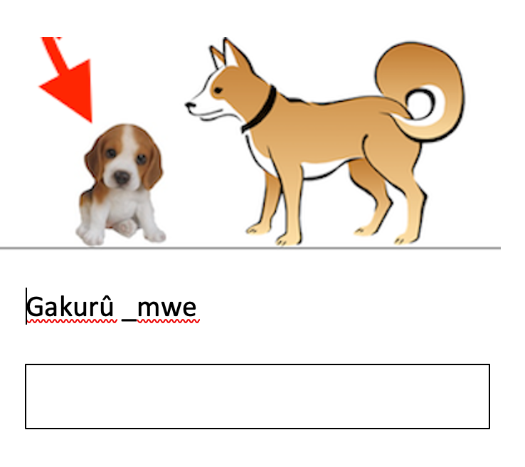
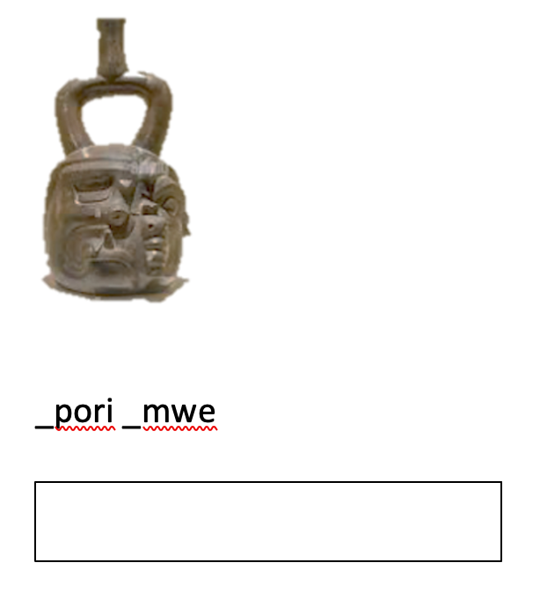
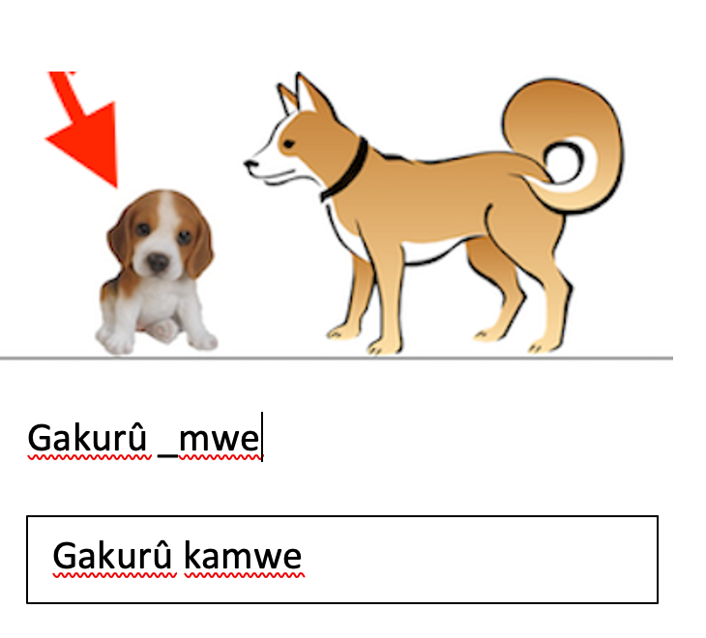
Sample Stimulus
Training Trial
Test Trial

